Slide 1
Sales Decline and Performance Analysis Report of Elite Crust Bakery
Presented by
Uduak JAMES

Slide 2

Analysis Report Of Sales Deline And Performance For of Elite Crust Bakery
Reporting Period
2023 Sales ANALYSIS

Slide 3
PROBLEM STATEMENT
Elite Crust Bakery, a growing retail bakery business, aims to analyze its sales, product performance, and customer data to improve business efficiency, increase profitability, and address declining sales in certain regions.
This Analysis Aims To:
Analyze sales trends to identify causes of revenue decline
Evaluate product performance and profitability
Compare store performance across regions
Understand customer behavior and retention patterns
Identify pricing and inventory inefficiencies
Provide data-driven recommendations to improve performance

Slide 4
DATASET OVERVIEW
Sales Data Sheet ; It contains date of sale, Category (Cakes, Pastries, Chocolates, Snacks) and quantity sold.
Product Data; it contains selling price (selling price per unit) stock available (units in stock) | supplier-_name.
Store Data’; it contains (unique store identifier) | store name (location name) region (Lagos, Abuja, kano, port Harcourt) | manager name.
Customer Data ; this table contains customer_name, age_group, gender ,etc (based on purchase history)

Slide 5
DATASET OVERVIEW
Sales Data Sheet;
Columns
• Transaction _ID (Unique ID for each sale) etc
Product Data
Columns
Product _id (unique id) | product_ name (product name)etc
Store data;
Columns
• Store _ID (Unique store identifier) | Store Name (Location Name) etc
Customer Data
Columns
• Customer-ID (Unique identifier) | Customer_ Name

Slide 6
DATA CLEANING & PREPARATION
Steps Taken to prepare the data for analysis:
Removed duplicates and handled missing values.
• Standardized column names and data types.
• Ensured date formats and numeric consistency.
Tools Used: Power Query in Power BI.

Slide 7
KEY METRICS - KPI MEASURED The following are key metrics to evaluate Elite Crust Bakery
Total Revenue
Total Profit
Profit Margin %
Total Customers
Total Units Sold
Average Order Value (AOV)

Slide 8
METHODOLOGY AND ANALYSIS
Methodology: Data analysis using Power BI,
filtering by key variables, and
comparing performance across regions, stores, products, and customers.
Analysis: Identified sales trends, regional gaps,
product profitability issues,
store performance differences, and
customer behavior patterns.

Slide 9
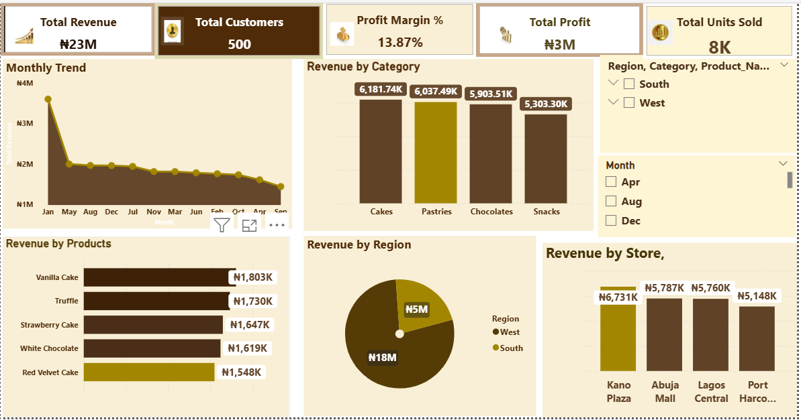
Elite Crust Bakery DASHBOARD

Slide 10
KPI ANALYSIS
Total revenue for the year is approximately ₦23 million, with a strong peak in January (₦3.6M) followed by a steady decline and fluctuations across the remaining months. Revenue generally weakened after Q1, with the lowest point around September (₦1.44M), before slightly stabilizing toward year-end.
This decline happens because demand is highest at the beginning of the year (holiday/seasonal effect), then reduces as customer spending slows down. Also, inconsistent promotions and changing demand across months affect sales stability.
Total profits ;The business recorded about 500 total customers, with higher customer activity in January (193 customers) and lower activity in some months like April and October (~101 customers).Customer numbers drop in some months due to low buying seasons, reduced promotions, or fewer returning purchases, which directly reduces sales volume.
Total Customers ; Total profit fluctuated across the year, with the highest in October (₦433K) and May (₦376K), while lower profits appeared in months like April and March.
Profit drops mainly because discounts are too high and some products are sold below cost price, reducing actual earnings even when sales happen.

Slide 11
KPI ANALYSIS
Quantity Sold ; A total of about 8,000 units were sold yearly, with the highest sales in January (1,000 units) and lower sales in months like October (581 units). The decline is linked to reduced demand after peak months and pricing/discount issues affecting purchase behavior.
Profit margins ;. The overall profit margin for the year is about 13.87%, showing moderate profitability. Margins were highest in October (24.99%) and May (18.82%), and lowest in April (8.27%). This fluctuation happens because high discount rates and selling below cost price reduce overall profit efficiency.

Slide 12
Products PERFORMANCE ANALYSES
High-performing products like Chocolate Cake and Vanilla Pastry generated strong profits due to high sales and low discount usage, showing effective pricing.
In contrast, products such as Fruit Cake and Strawberry Cupcake recorded losses as they were sold below cost price and heavily discounted.
Black Forest Cake saw increased sales from discounts, but profits remained low due to thin margins. Meanwhile, Meat Pie maintained stable performance without heavy discounts, indicating good pricing strategy.
Overall, losses across products were mainly driven by excessive discounting and selling below cost, while profitable products relied on controlled pricing and strong demand.

Slide 13
Categories Analysis
Cakes generated the highest revenue and profit, driven by strong demand and relatively controlled discounting, making it the most valuable category.
Pastries also performed well with steady revenue and moderate profit, though slightly affected by occasional discounts.
Chocolates showed good revenue but lower profit margins due to higher discount application. In contrast,.
Snacks underperformed, contributing lower revenue and minimal profit as a result of frequent discounting and some products being sold close to or below cost price. Overall, while Cakes and Pastries drive profitability, Chocolates and Snacks require better pricing and discount control to improve margins.

Slide 14
Store Performance Analysis
Across all stores, high discount rates are directly affecting profitability, even when revenue is strong. Stores are performing well in sales volume, but profit efficiency is reduced due to aggressive discounting and possible pricing strategy issues.
Abuja Mall generated (₦5,786,865m) and profit (₦438,713) with 2,121 units sold, showing strong demand despite a high discount rate (385%).
Kano Plaza recorded the highest revenue ₦6.73M revenue and ₦1.28M profit, selling the highest quantity (2,308 units), heavy discounts (409%) generating the highest profit efficiency.
Lagos Central made ₦5.76M revenue and ₦848K profit from 2,093 units sold, but high discounting (357%) limited its profitability performance
.
Port Harcourt Hub had the lowest revenue (₦5.15M) and lowest sales volume (1,868 units), with ₦696K profit and the lowest discount rate (335%), indicating stable but low-scale performance.

Slide 15
Customers Behavior And Inventory Analysis
Customer retention is strong at 100% (500 repeat customers), showing high loyalty across all stores. The 18–25 and 50+ age groups generate the highest revenue (₦5.88M and ₦6.45M), with males contributing more revenue than females across all segments, especially in the younger group.
In terms of store retention, Abuja Mall performs best overall, followed by Kano Plaza, while Lagos Central and Port Harcourt Hub show lower retention levels, especially among younger customers. Overall, revenue is driven mainly by key age groups and male customers, while some stores need improved engagement strategies to strengthen retention and performance.

Slide 16
Product Recommendations
Products are generating high revenue but suffering from profit loss due to excessive discounts and selling below cost price.
The business should review pricing strategy, especially for loss-making items like red velvet cake, truffle chocolate, white chocolate, muffins, and some snacks.
Discounts should be controlled and targeted, not applied across all products. Focus should shift to high-margin products (cakes, pastries, dark chocolate, croissants, eclairs) while phasing out or reformulating consistently loss-making items.

Slide 17
Customer Recommendations
Customer retention is strong (100%), but revenue is heavily driven by few age groups and male customers, especially ages 18–25 and 36–50.
The business should create targeted promotions for underperforming segments (female customers and older age groups in low-engagement stores). Loyalty programs can be introduced to maintain retention while increasing purchase frequency and average order value.

Slide 18
Store Recommendations
Abuja Mall and Kano Plaza are strong in revenue but suffer from over-discounting, while Lagos Central shows low profit efficiency, and Port Harcourt Hub has low sales volume.
Stores should adopt a standardized discount policy to prevent profit leakage. Lagos Central needs profit improvement strategies, while Port Harcourt Hub requires marketing and demand generation campaigns to increase customer traffic and sales volume.

Slide 19
Category Recommendations
All four categories (cakes, chocolates, pastries, snacks) generate revenue, but profitability is uneven due to poor pricing control in certain products within each category.
Cakes and pastries are the best performing categories, while chocolates and snacks suffer losses due to discounts and underpricing. The business should focus investment on high-performing categories, reduce discounts on weak products, and optimize product mix within each category.

Slide 20
Conclusion
The business recorded strong performance with ₦23M revenue, 8,000 units sold, and a 13.87% profit margin, showing good market demand. However, performance was inconsistent across months, with a peak in January followed by fluctuations due to seasonal changes and pricing effects.
At the store level, Abuja Mall and Kano Plaza performed best, while Lagos Central showed weaker profit efficiency and Port Harcourt Hub had the lowest scale.
Across products, cakes and pastries were the top revenue drivers, but several products in chocolates and snacks recorded losses due to high discounts and selling below cost price.
Overall, the key issue is not demand but profit leakage caused by excessive discounting and poor pricing control, which reduced overall profitability despite strong sales.

Slide 21

Thank you

